Slide 1
Problem Solving -Computational, critical and design thinking
A Brief presentation
By the
16th presenters

Slide 2
Problem solving 1: Computational and critical thinking Scenario 1 Logo Making

Slide 3
Problem 1: Ana’s logo planning
Client Name: Ana
Occupation: Owner of a Salon (To be established)
Concerns: preparation and design planning of her salon’s brand logo
Task: Aid Miss Ana in creating a brand logo for her salon business.

Slide 4
Questions:
1) What are the software and devices to be used in creating the brand logo?
2) Is it an online platform, or not? If yes, what online platform? If not, what platform are you going to use.
3) What important features must be present in creating the brand logo?
4) What could be the potential problems that might be incurred and how can you initially address the problems?

Slide 5

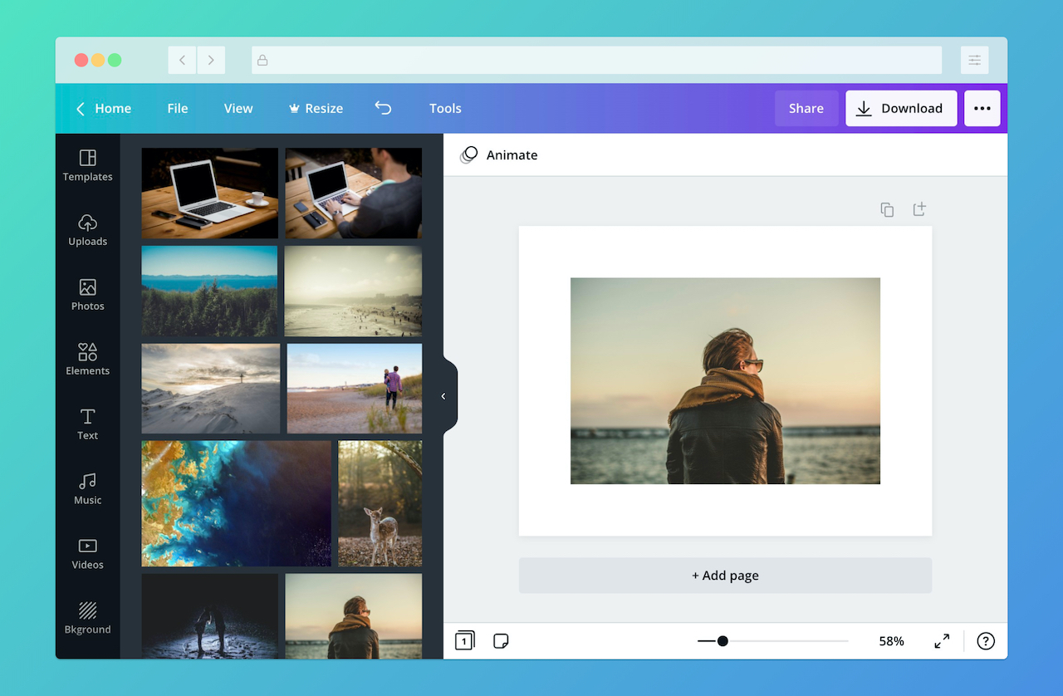

1) What are the software and devices to be used in creating the brand logo?
Desktop Computer or Laptop

Slide 6
2) Is it an online platform, or not? If yes, what online platform? If not, what platform are you going to use.
CANVA is an online platform.
Can be accessed through search engines like Google.
Free for all users who sign up. Can sign in through Gmail or Facebook.

Slide 7
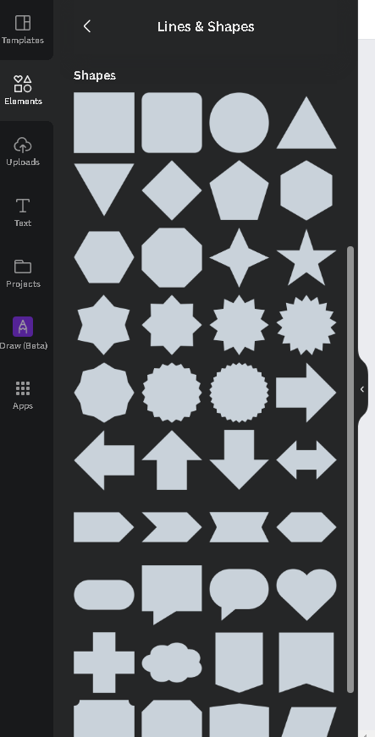
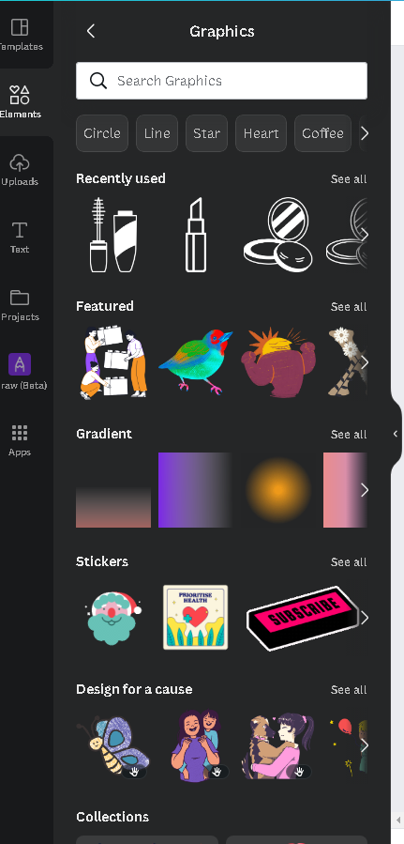
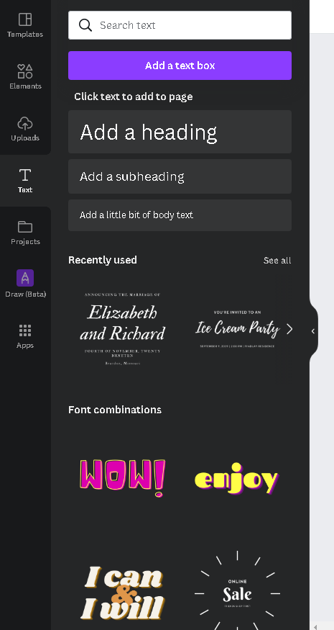
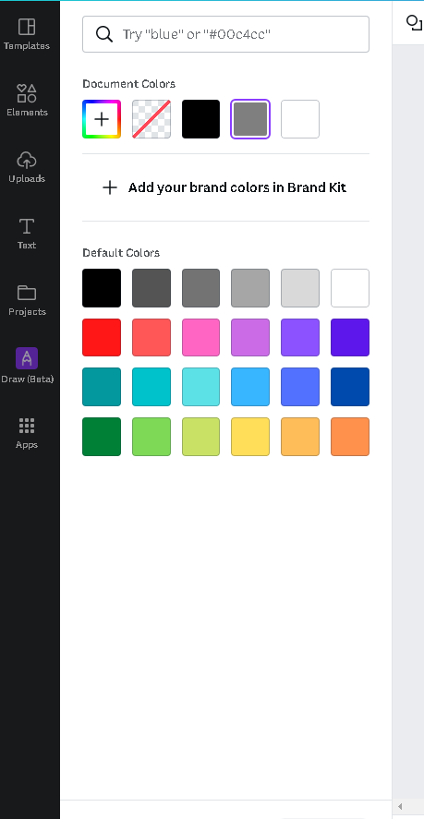
3) What important features must be present in creating the brand logo?
Lines and Shapes
Graphics
Text Options
Color Options

Slide 8





4) What could be the potential problems that might be incurred and how can you initially address the problems?
POOR DESIGN CHOICES
OVERCROWDING OF ELEMENTS

Slide 9
Problem solving 2: DESIGN THINKING Scenario 2 LAPTOP SALES PITCH

Slide 10
Problem 2: “Why should I buy this laptop?”
Concern: A customer (a company executive secretary) wishes to purchase a laptop for her office work.
Client Needs: She mainly uses productivity tools like Microsoft Office (Word, Excel, PowerPoint) and web browsers for daily tasks and videoconferences.

Slide 11
Client also uses Google Workspace (Gmail, Calendar, Drive Docs, Sheets, Slides, Meet, and more).
Client uses Google Hangouts to communicate with her boss and colleagues.
Client stores lots of files on her old laptop, and seeks to transfer them to a new one.
Client prefers a lightweight laptop for use during her travels.
Client has a 19k peso budget, and seeks advice on what laptop to purchase.

Slide 12
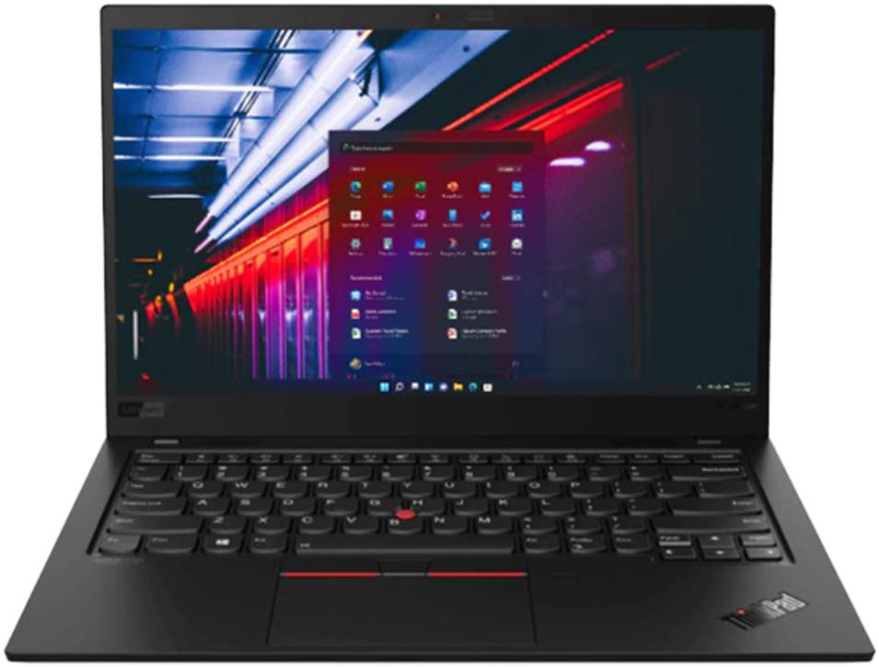
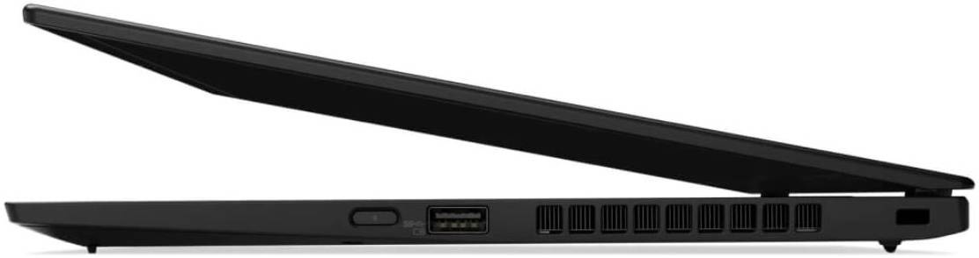
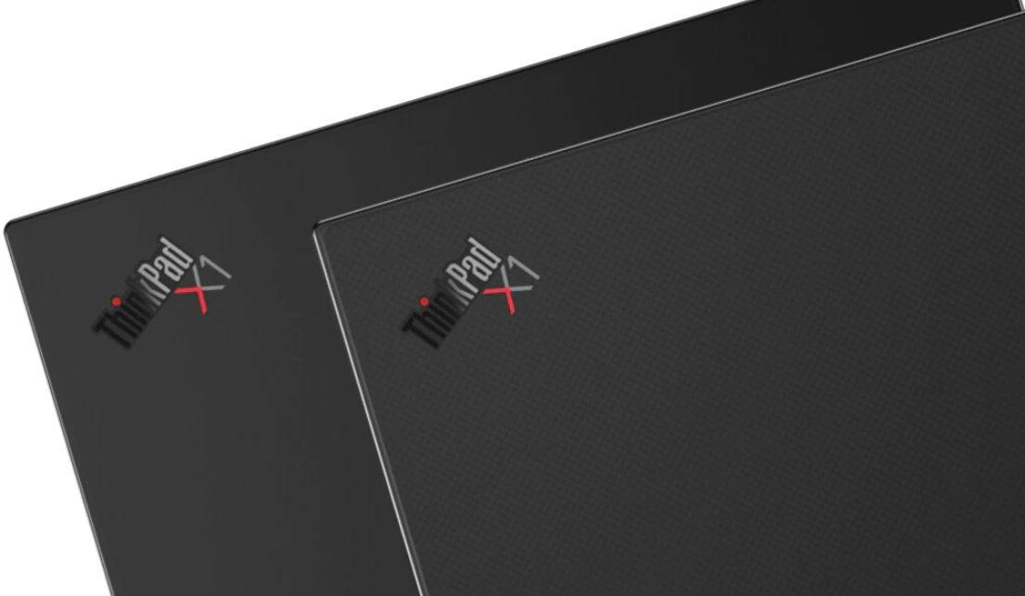
Recommendation?
Lenovo X1Carbon 14” Touchscreen Display Laptop

Slide 13
“WHY Lenovo X1Carbon 14” Touchscreen Display Laptop?”
Lenovo X1Carbon 14” Touchscreen Display Laptop
Price: 21,449 pesos
Cash: less (1000) pesos
Installment Plan: 25,738 pesos monthly payment

Slide 14
Specifications and benefits
Renewed – Lenovo X1 Carbon
- Carbon fiber material, strong and light.
14” Touchscreen Display
Streamline navigation
5th Gen i7 Intel Core Processor
Quick and speedy processing

Slide 15
8GB RAM
Run apps and open browser tabs with no issues
256GB SSD
No memory shortages, will last long.
Windows 10 Home
- Better security features

Slide 16
-THE BIGGER PICTURE-
Budget and Cost will break-even in the long run.
The laptop, depending on use, will last longer.
The laptop features should be up to date for as long as it can.
It’s a worthwhile investment to take.

Slide 17
Final thoughts
Our client should consider purchasing the laptop. The initial price and its installment cost will break-even before the laptop’s expected life, and the laptop’s features are overall, beneficial for our client’s needs in the long run.

Slide 18
This marks the end of the presentation Thank you for listening

Slide 19
SAMPLE SCREENSHOTS OF CANVA INTERFACE

Slide 20
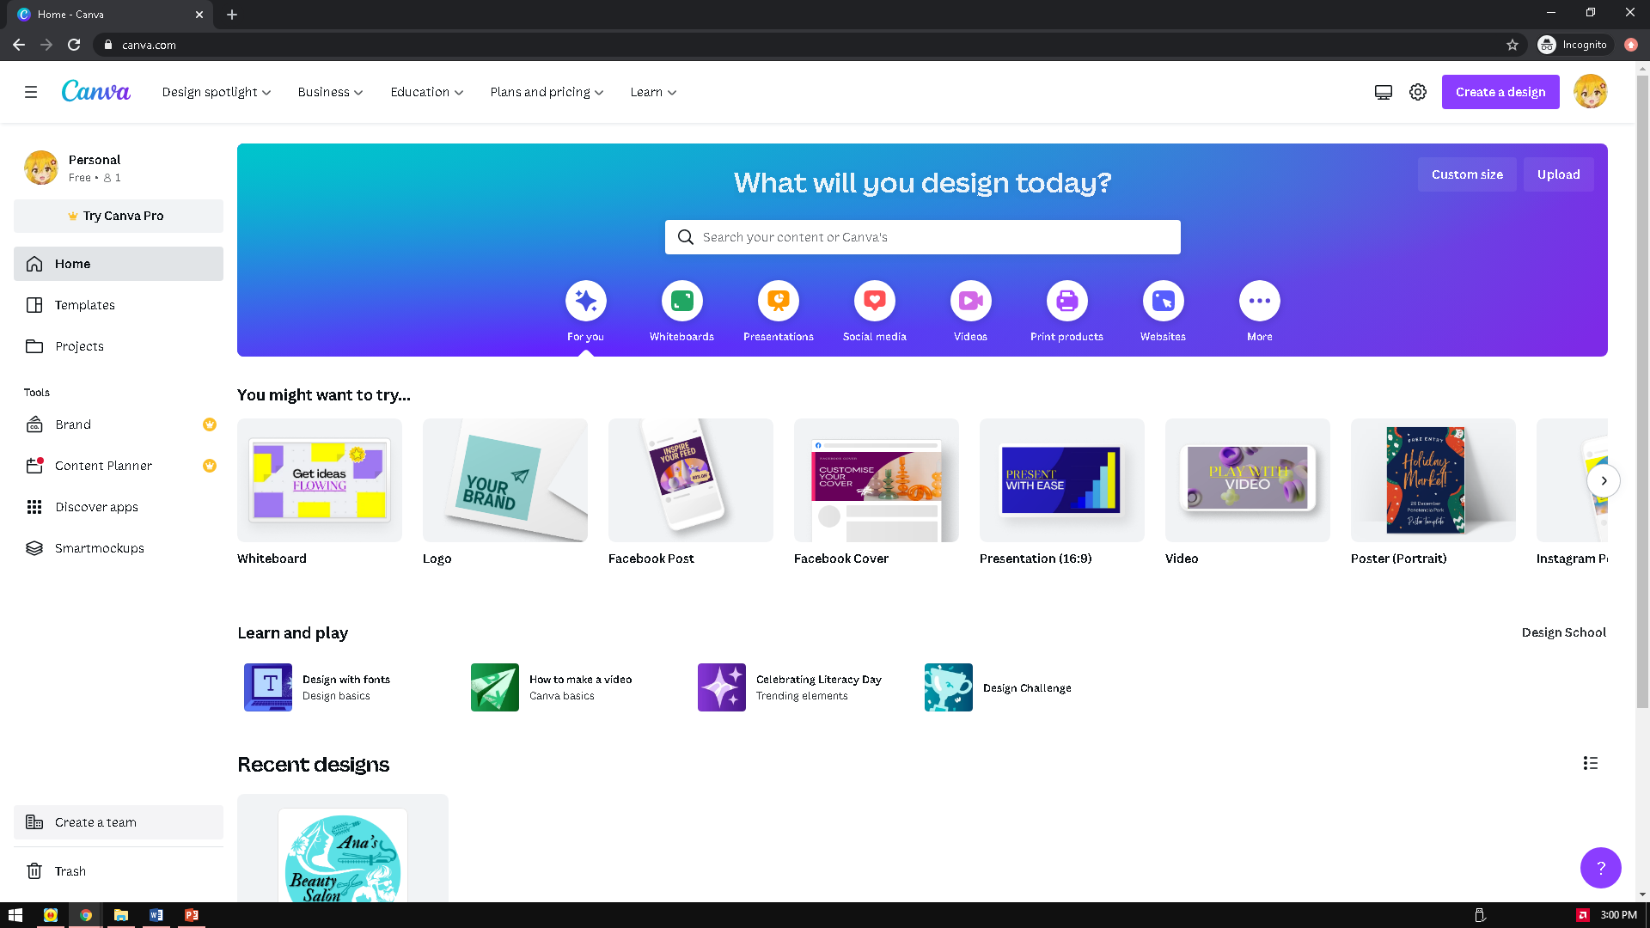

Slide 21
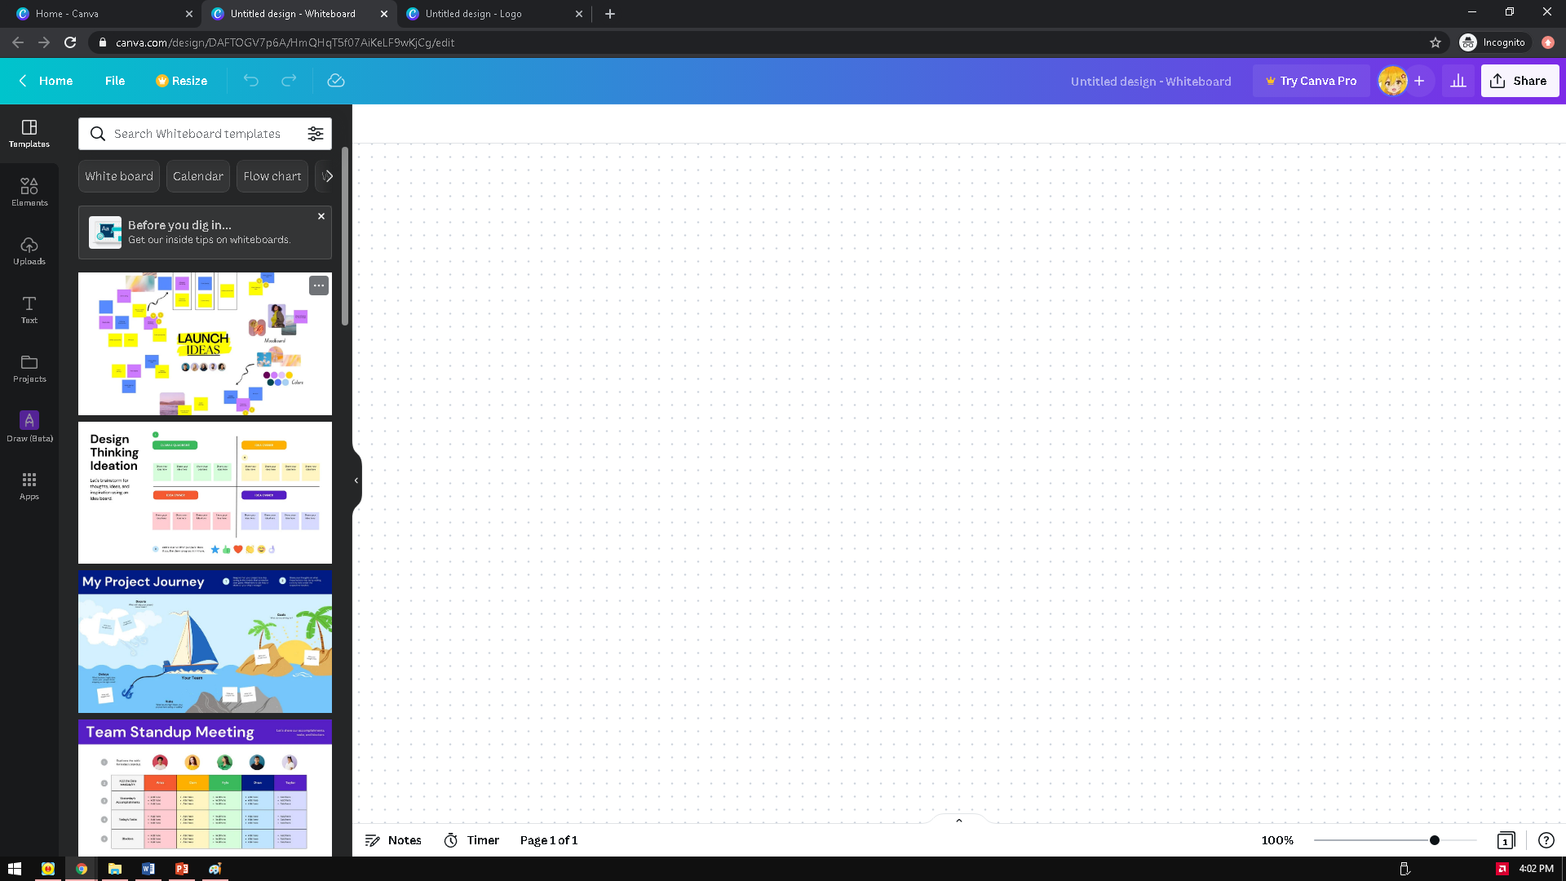

Slide 22
